Slide 1
ACM final Practical
Ankit Chawla(07)

Slide 2
Problem statement
Our aim is classify the performance of students as good(1) or bad(0) appeared in 3 kinds of test and measured with the following
Data from temperature sensor expressed degrees on the Celsius (°C) scale.
Data from the electrodermal activity sensor expressed as microsiemens (μS).
Data from photoplethysmograph.
Data from 3-axis accelerometer sensor. The accelerometer is configured to measure acceleration in the range [-2g, 2g]. Therefore the unit in this file is 1/64g. Data from x, y, and z axis are respectively in first, second, and third column.
Average heart rate extracted from the BVP.

Slide 3
Dataset overview
A total of 10 students were recorded for 3 different examinations.
Therefore a total of 30 exam readings of time series data
Mid term exams are of 1.5hrs and final examination of 3hrs

Slide 4
Methodology
Each signal attribute was converted into the freq of 1hz to sync the whole data.
Mean of points were taken for the features with highfreq rate to convert it into 1hz
Then the data of each exam by every student was reduced by taking the mean of the 5 secs windows
Further on, only those points were taken into consideration for which the value is 3 std deviation away from the mean for a feature.
Now we take the mean of each feature for the selected points.
This would result in 1 data point per examination of a student
each exam by a student = 1 data point.
Total of 3 datapoints per student(3 exams) and 10 students
Therefore a total of 30 data points

Slide 5
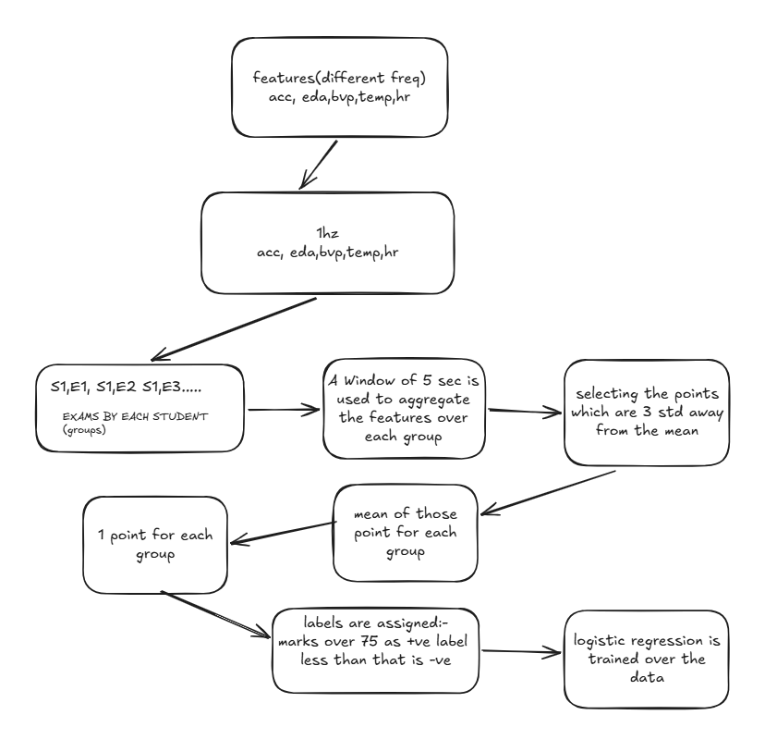

Slide 6

Results

